Slide 1
MOLSIM project
sabiha

Slide 2
biphasic system
Step1: creating box with cyclohexane. Energy minimization, npt,nvt.
Step2: Before solvating the system, make sure that the cyclohexane molecules are not wrapped across the z periodic direction.
gmx trjconv -f nameofgrofile -o outputnameofgrofile -pbc whole
Step3: extend the box and solvate with water.
Equilibrate the system with short em,npt,nvt. Run 100ns production run.

Slide 3
Building box

Slide 4
# of walkers | # of nodes | MPI ranks/walker | OMP threads/rank | ns/day/walker | total ns/day
1 | 1 | 1 | 1 | 4.527 | 4.527
1 | 1 | 2 | 1 | 8.498 | 8.498
1 | 1 | 4 | 1 | 16.227 | 16.227
1 | 1 | 8 | 1 | 28.682 | 28.682
1 | 1 | 16 | 1 | 48.342 | 48.342
1 | 1 | 8 | 2 | 42.557 | 42.557
1 | 1 | 4 | 4 | 46.724 | 46.724
1 | 1 | 2 | 8 | 44.027 | 44.027
1 | 1 | 1 | 16 | 48.788 | 48.788
2 | 1 | 8 | 1 | 27.223 | 54.446
4 | 1 | 4 | 1 | 14.140 | 56.56
8 | 1 | 2 | 1 | 7.232 | 57.856
2 | 2 | 16 | 1 | 48.362 | 96.724
4 | 2 | 8 | 1 | 27.177 | 108.708
8 | 2 | 4 | 1 | 14.176 | 113.408

Slide 5
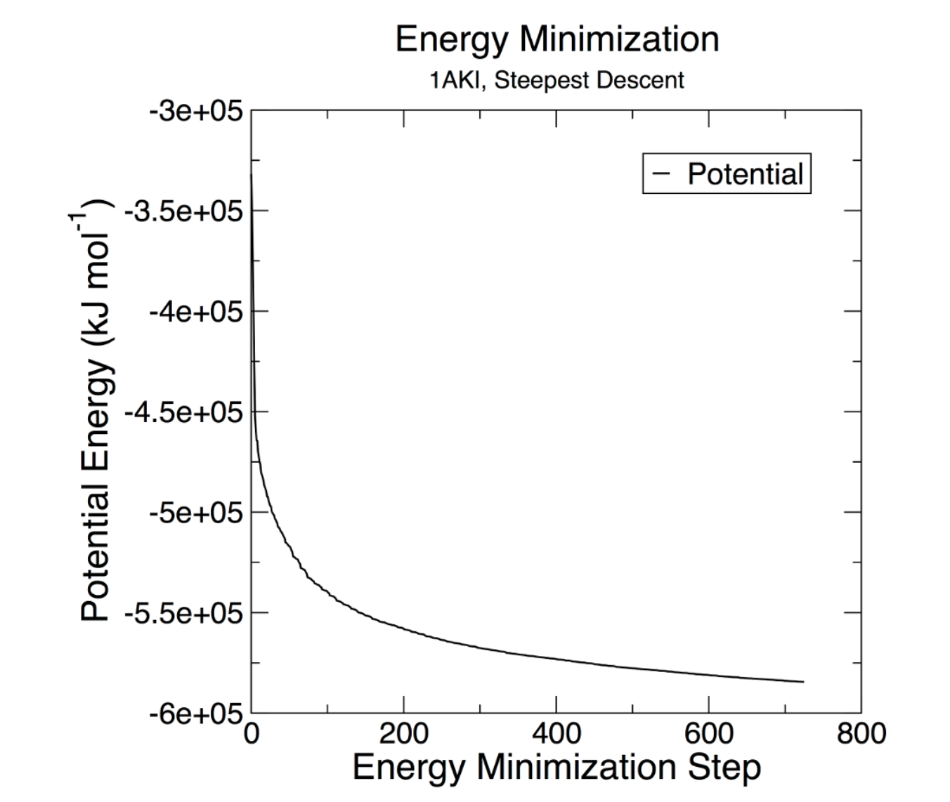
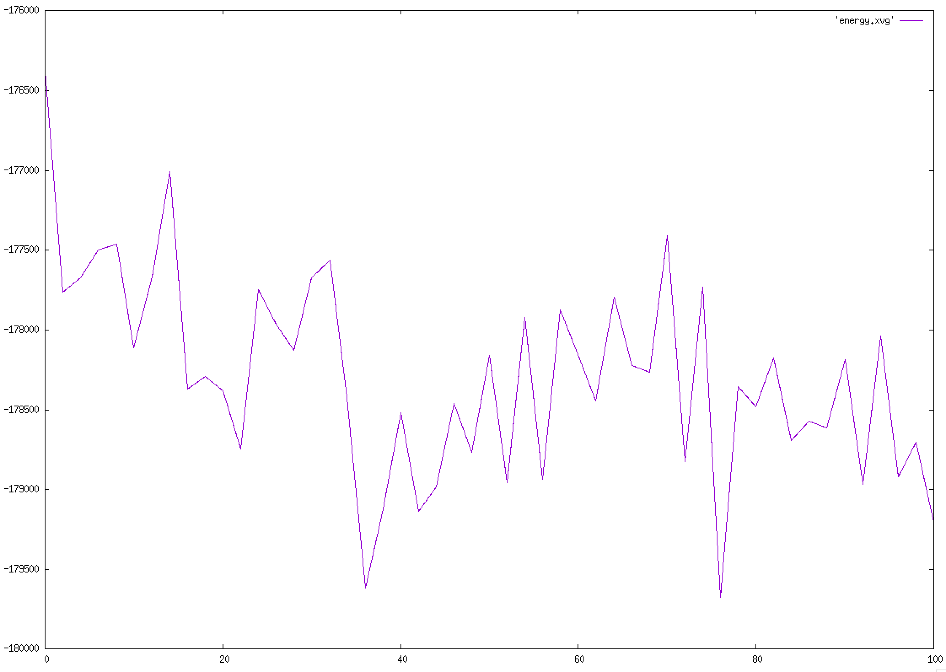
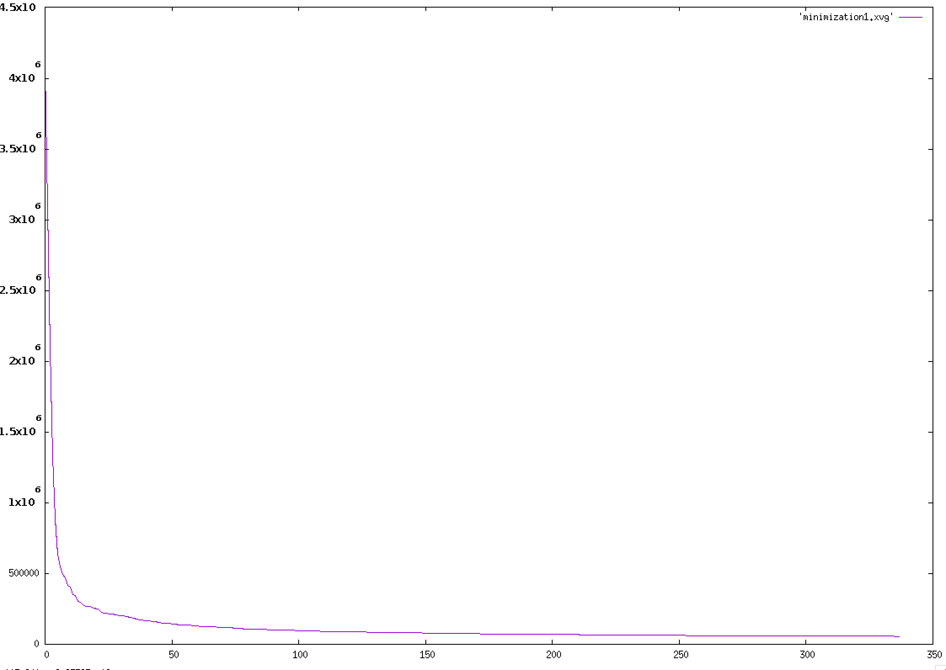
What other analysis?
gmx energy: The em.edr file contains all of the energy terms that GROMACS collects during EM. You can analyze any .edr file using the GROMACS energy module.
Plot xvg files using gnuplot:
set datafile commentschars "#@&”

Slide 6
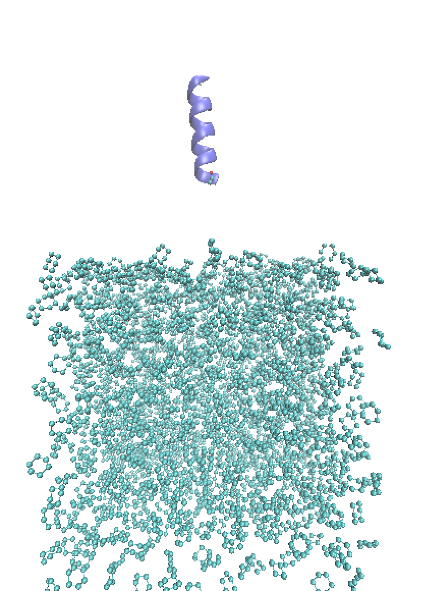
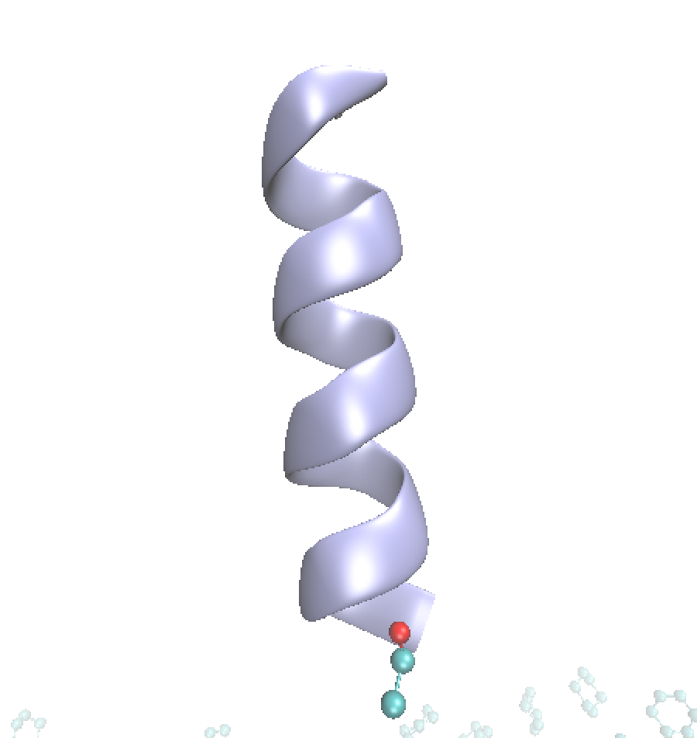
biphasic system with protein in water

Slide 8
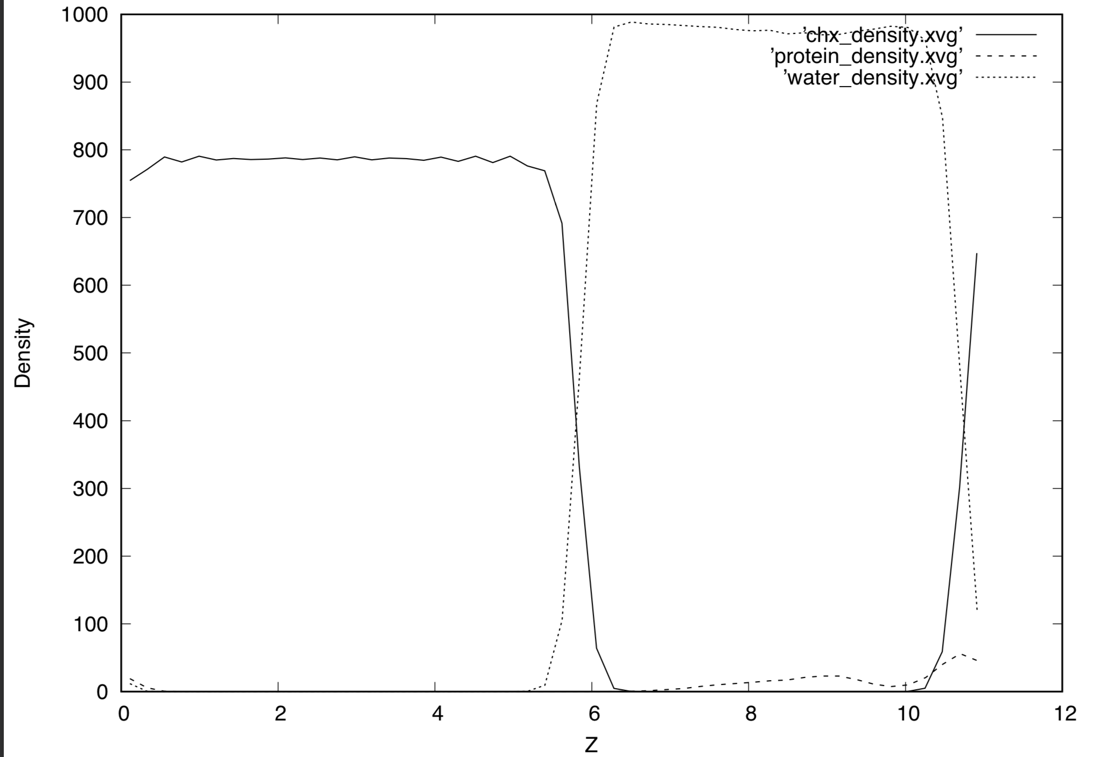
Using gmx density…

Slide 9
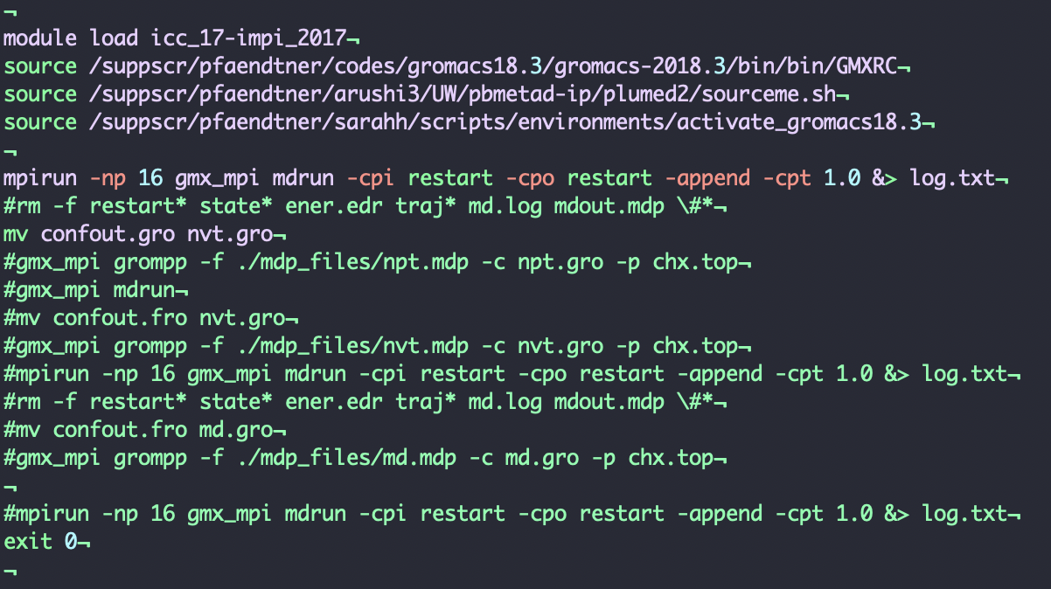
Don’t do this….

